Slide 1
Temperature Prediction
Anuj Tanwar

Slide 2

Content
Introduction - Why do we need weather prediction
How do I plan to predict Weather
Exploring data (EDA) and trends
Data Modeling
Predictions
Conclusion
Source

Slide 3
Introduction – Why Predict Weather
Weather is essential for survival
Crucial for lot of businesses
Can effect the food we eat
Timely warnings can protect life and property
Can be used by utilities companies to estimate demands
Can help in planning for transportation hazard
Can help lawn maintenance businesses and personal use (e.g. Fertilizing, bug spray, etc)
Can help prepare for the day better (might need a jacket or an umbrella)

Slide 4
How do I plan to Predict Weather?
Collect Weather Data
Data Cleaning &
Pre-Processing
EDA (Exploratory Data Analysis)
Model Evaluation Process
Training of Model
Apply LSTM Model
Predictions
Training Dataset

Slide 5
How do I plan to Predict Weather?
Global Land Temperatures By Major City dataset used.
Data Cleaned by dropping duplicates, filtering outliers, taking care of nulls, etc.
Used Visualizations to understand the data better.
LSTM (Long short-term memory) was used for modelling.
Model accuracy was calculated plotting predicted values Vs real values from test dateset.

Slide 6
Variables in the Dataset
dt: Date
AverageTemperature: Average Temperature during the day
AverageTemperatureUncertainty: 95% confidence interval around the average temperature
City: City where temperature was taken
Country: Country of location
Latitude: Latitude of the location
Longitude: Longitude of the location

Slide 7
Exploratory Data Analysis
Handling missing values
Dropping duplicate values
Filtering data for the city of user’s choice: Used Fuzzy Matching
Exploring data using different Visualizations
Handing outliers

Slide 8
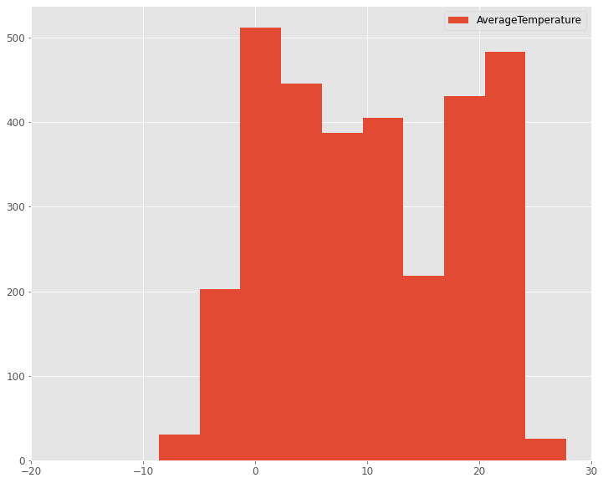
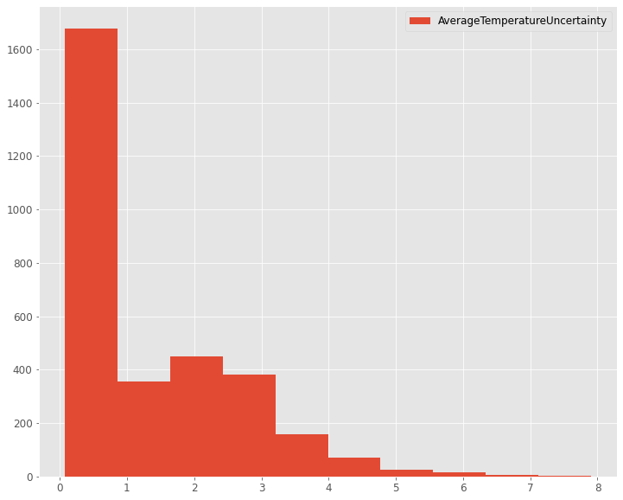
Variable Histograms

Slide 9
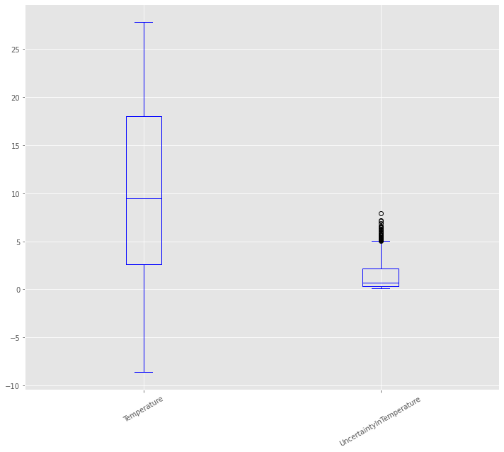
Variable - Outliers
Looking at the histograms, there are no obvious outliers in the variables.
Checking outliers with box plot in temperature:
Looking at the box plot, there are some outliers:
Variable Templerature Uncertainty has outliers above the value of 5

Slide 10
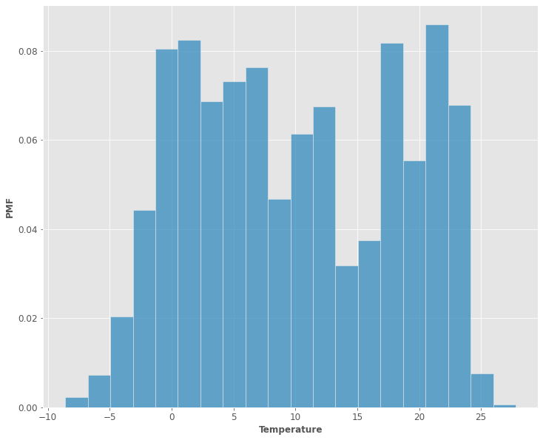
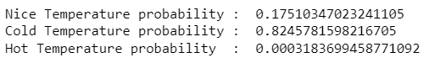
Probability Distribution
Taking PMF of AverageTemperature and calculating 3 more variables for comparison of temperature:
Nice Temperature : Ranging 20-27
Cold Temperature : Less than 20
Hot Temperature : More than 27

Slide 11
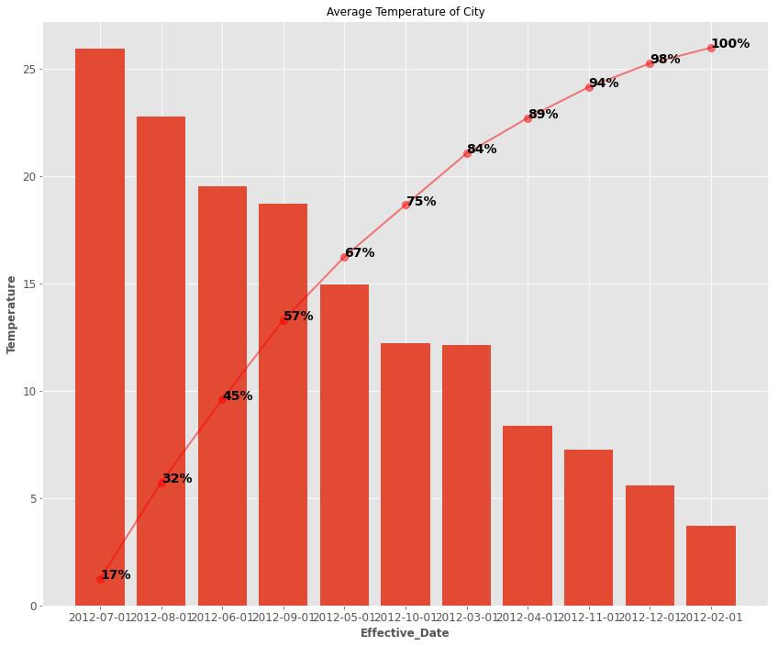
Pareto Distribution
Plotting Pareto Distribution of one city for one year for showing how temperature changes over different months. It shows that June to Sep months have good temperature in Chicago and rest of the months are colder.

Slide 12
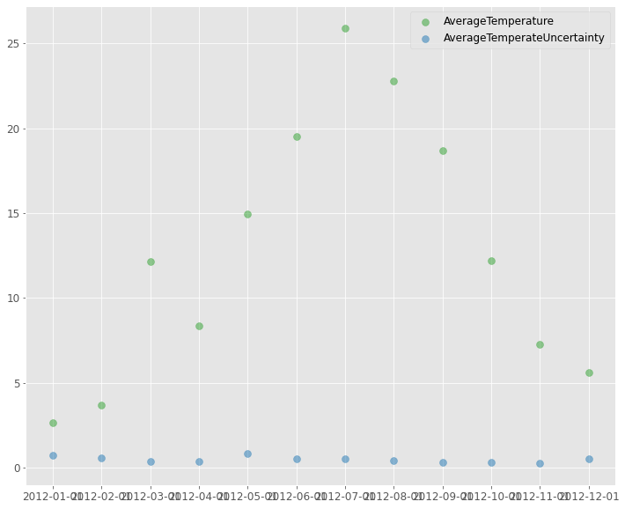
Scatter Plot (Correlation)
Scatter plot of between Temperature and Temperature Uncertainty parameters, there is no direct correlation. Level of Temperature Uncertainty is high in May, however Temperature is high in July.

Slide 13
Test Hypothesis
Null Hypothesis Statement: Temperature in Chicago in the month of September will go below 15
Null Hypothesis is used to test validity of a statement
I used it to see if temperature in Chicago in Sep can get below 15
Null Hypothesis suggests, it won’t be below 15 in Chicago in September
Since P-value is 0.01, we can say our Null Hypothesis can be rejected and Temperature in Chicago will not be below 15 in September

Slide 14
Predictive Modeling
LSTM was carried out on Chicago Data for a time series.
Data was divided into test and train datasets. Last year of data was set as test dataset and rest as train dataset.
For every month, difference between current and previous month temperature was calculated.
That difference in temperature was used for predictions.
Actual values and predicted values were plotted together.
Plot suggest Actual and Predicted values are close.

Slide 15
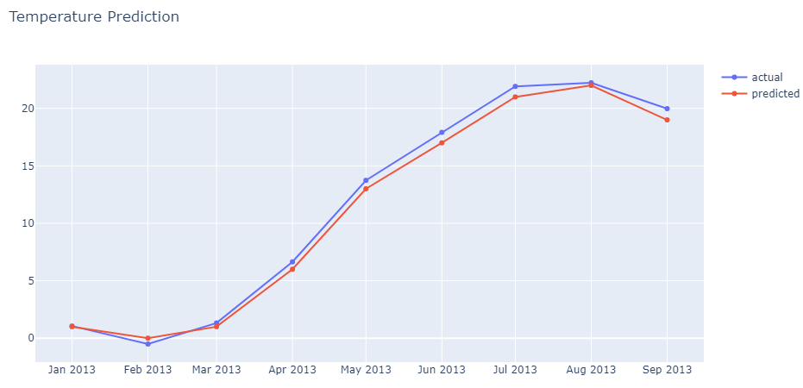
Prediction - Conclusion
Plot indicates our model predicts the values close to actual which means model is accurate.

Slide 16
Sources
https://www.kaggle.com/berkeleyearth/climate-change-earth-surface-temperature-data?select=GlobalLandTemperaturesByMajorCity.csv

Slide 17
The End

